Slide 1
RC Ring-Controller
Shimi Haleluya
Tzahi Perez
Adviser: Amichai Ben-David (Intel)

Slide 2

Introduction
Architecture
LOTR
RC -> This is Us
Execution
What was the Mythology
Work-Flow
Tools
Environment

Slide 3
The Architectural idea

Slide 4
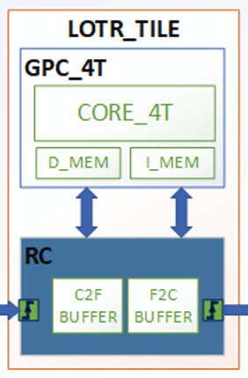
Building Blocks
Computational Block
RISCV Core

Slide 5
Building Blocks
The “Router” – Our IP
The IO Block. In charge traffics managing & coherency.

Slide 6
Building Blocks
Together they build the “LOTR_TILE”

Slide 7
Building Blocks
Many Tiles together will make A RING architecture Fabric.

Slide 8

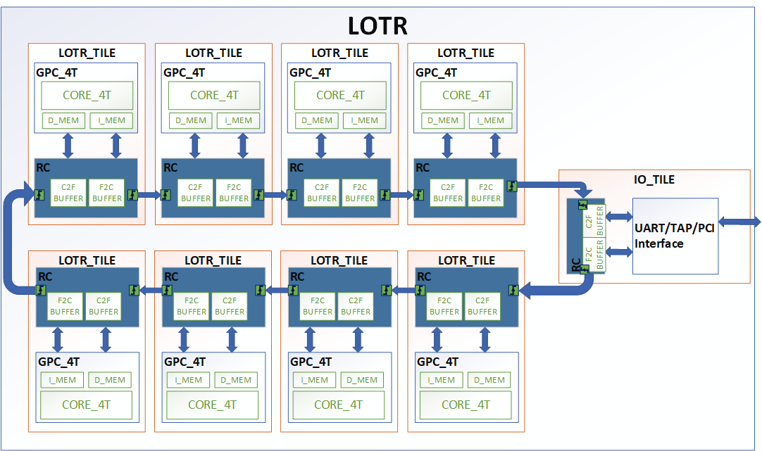
Lord-Of-The-Ring

Slide 9
Lord-Of-The-Ring
Typical Flow:
Load I_MEM

Slide 10
Lord-Of-The-Ring
Typical Flow:
Load I_MEM
Execute Program – Local D_MEM

Slide 11
Lord-Of-The-Ring
Typical Flow:
Load I_MEM
Execute Program – Local D_MEM
Access Non-Local D_MEM

Slide 12
Lord-Of-The-Ring
Other options for Memory Mapped Agent:
Have an “Accelerator–Agent” instead of CORE for specific HW Accelerate calculation.
Accelerator

Slide 13
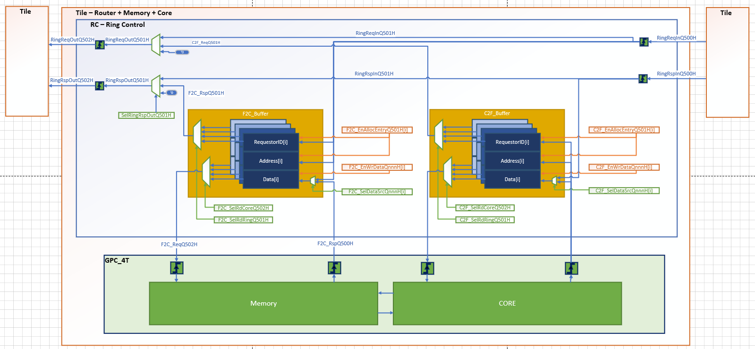
Ring-Controller

Slide 14
Ring-Controller
Data Path:
Core Request

Slide 15
Ring-Controller
Data Path:
Core Request
Memory Response

Slide 16
Ring-Controller
Data Path:
Core Request
Memory Response
Ring Input
Pass through

Slide 17
Ring-Controller
Data Path:
Core Request
Memory Response
Ring Input
Pass through
F2C RD/WR to local Mem

Slide 18
Ring-Controller
Data Path:
Core Request
Memory Response
Ring Input
Pass through
F2C RD/WR to local Mem
C2F RD_RSP

Slide 19
Ring-Controller
Example full Flow:
RD From Core -> RD_RSP From Ring

Slide 20
Ring-Controller

Slide 21
Ring-Controller

Slide 22
Ring-Controller

Slide 23
Ring-Controller

Slide 24
Ring-Controller

Slide 25
Ring-Controller

Slide 26
Ring-Controller

Slide 27
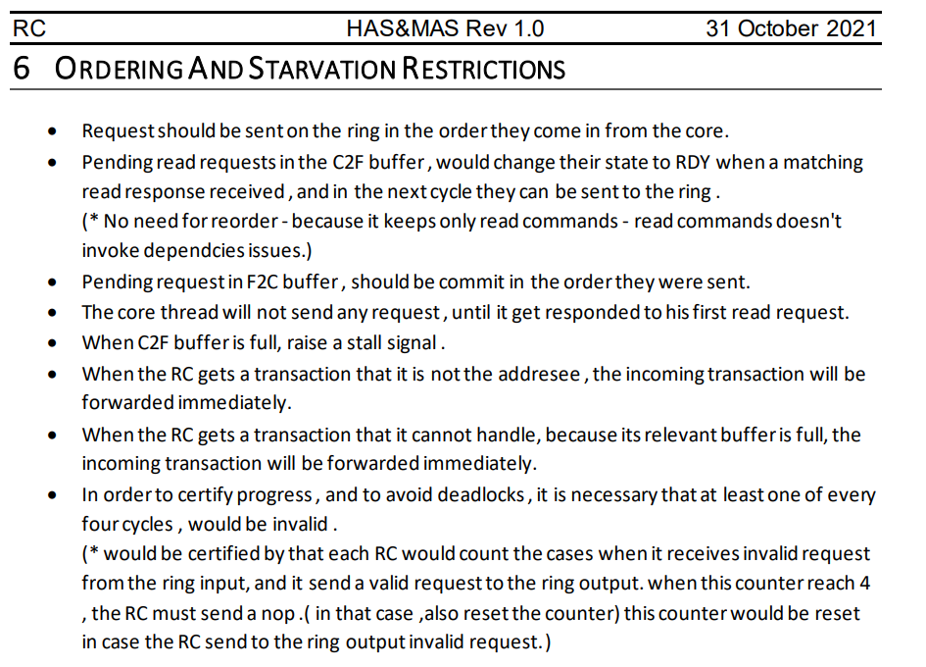
MRO
There are many constraints for the arbitration scheme:

Slide 28
MRO
One of the most important arbitration condition:
“Each entry in the C2F & F2C must be served the req/rsp in the allocation order”
Therefore, we designed the MRO: “Matrix Remember Order”

Slide 29
MRO
This micro architecture allow us to arbitrate the buffer candidates correctly

Slide 30
C2F & F2C State Machine & Ctrl Bits
The “State Machine” is a function of the current State + feedback from design.

Slide 31
C2F & F2C State Machine & Ctrl Bits
Note the MRO as a key component for the State machine logic.

Slide 32
C2F & F2C Buffers Data Path
The “ctrl bits” control the “Data Path” allocation and deallocation from Buffer

Slide 33
Workflow & Execution

Slide 34
HAS & MAS
HAS: High Level Architecture Specification
What we need to support.
MAS: Micro Architecture Specification
How we implemented it.
*In this project we merge the two into a single spec

Slide 35
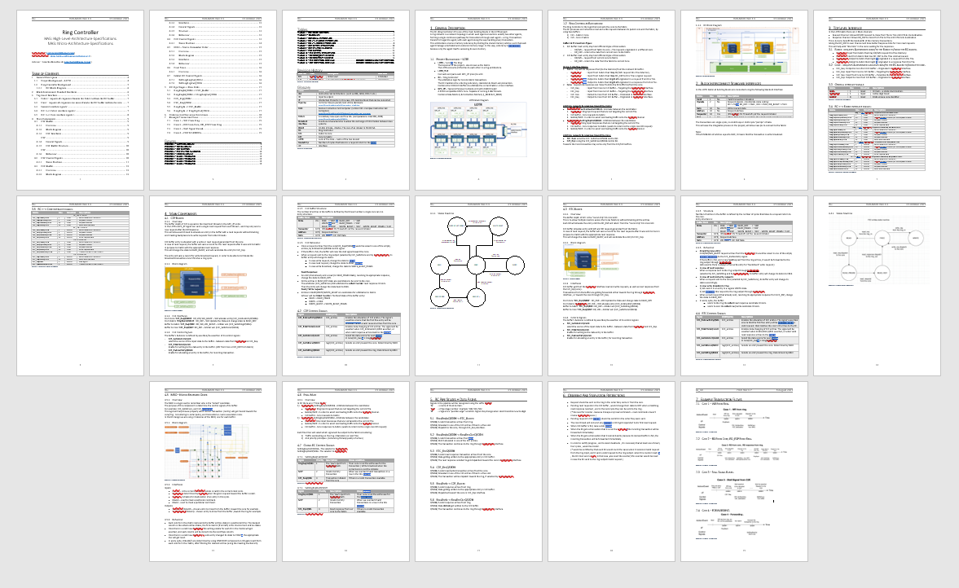
HAS & MAS
All details are in this Spec & github: https://github.com/amichai-bd/riscv-multi-core-lotr

Slide 36
Verilog Simulation
Technion VNC Linux Environment Using “VCS” && “VERDI–FSDB”
Compilation
Elaboration
Simulation
Wave tracker - Debug

Slide 37
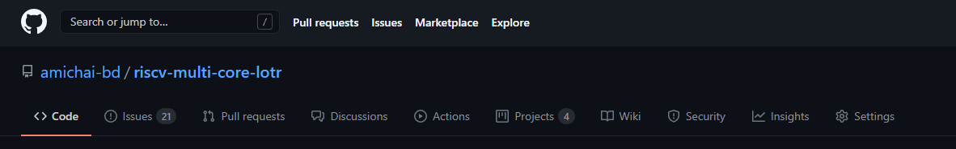
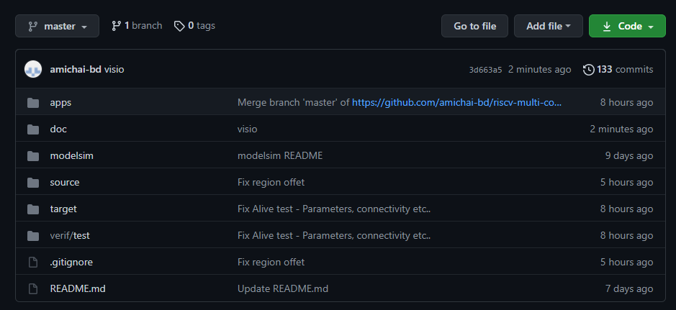
GitHub
https://github.com/amichai-bd/riscv-multi-core-lotr

Slide 38
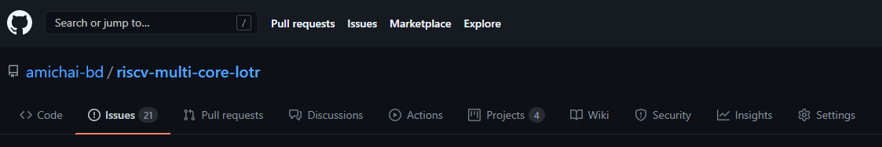
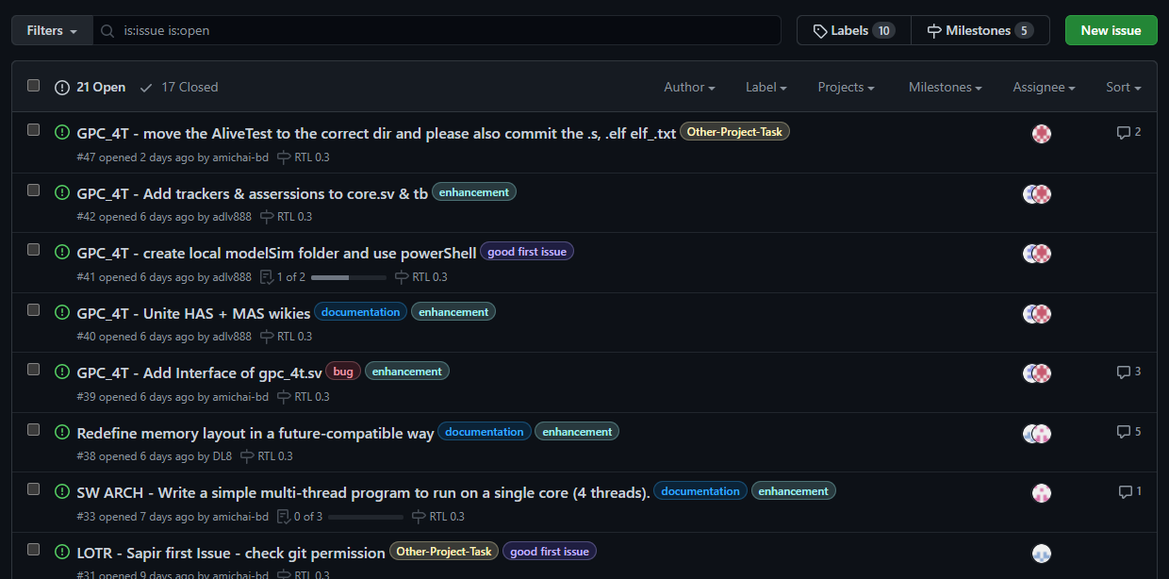
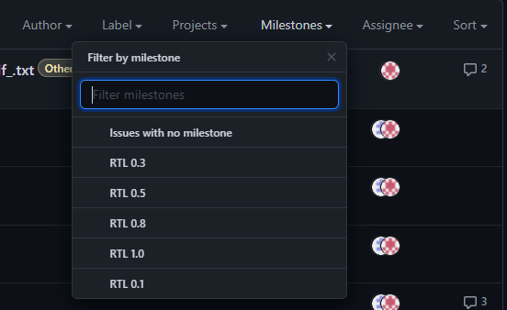
GitHub
https://github.com/amichai-bd/riscv-multi-core-lotr

Slide 39
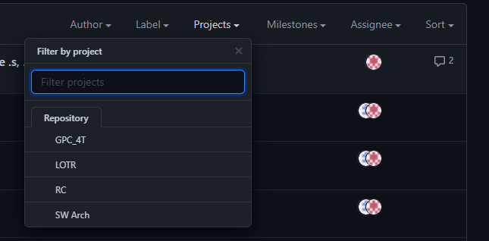
GitHub
https://github.com/amichai-bd/riscv-multi-core-lotr

Slide 40
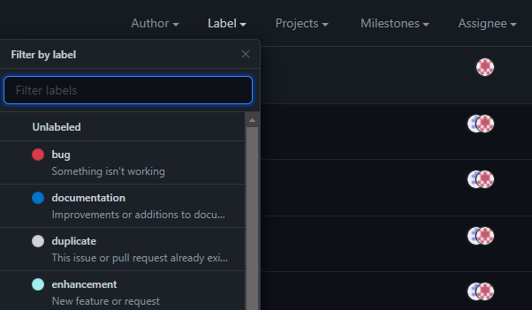
GitHub
https://github.com/amichai-bd/riscv-multi-core-lotr

Slide 41

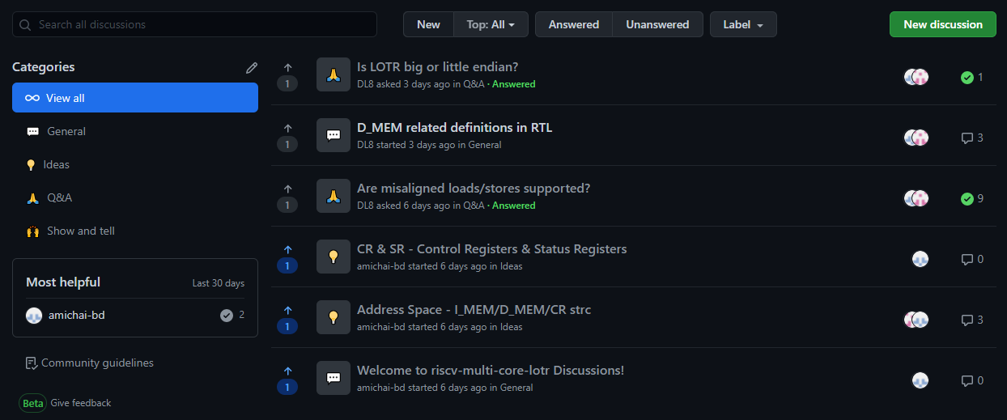
GitHub
https://github.com/amichai-bd/riscv-multi-core-lotr

Slide 42
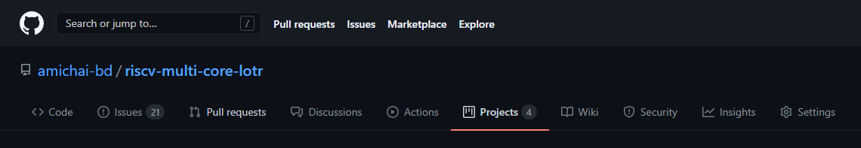
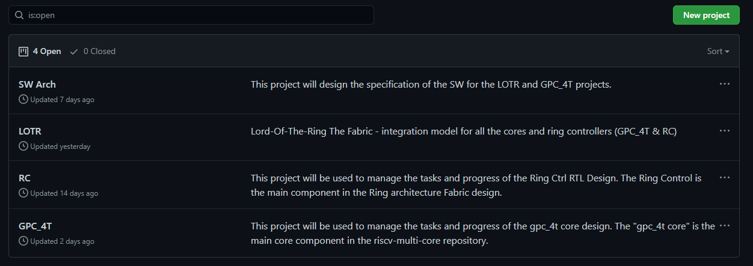
GitHub
https://github.com/amichai-bd/riscv-multi-core-lotr

Slide 43
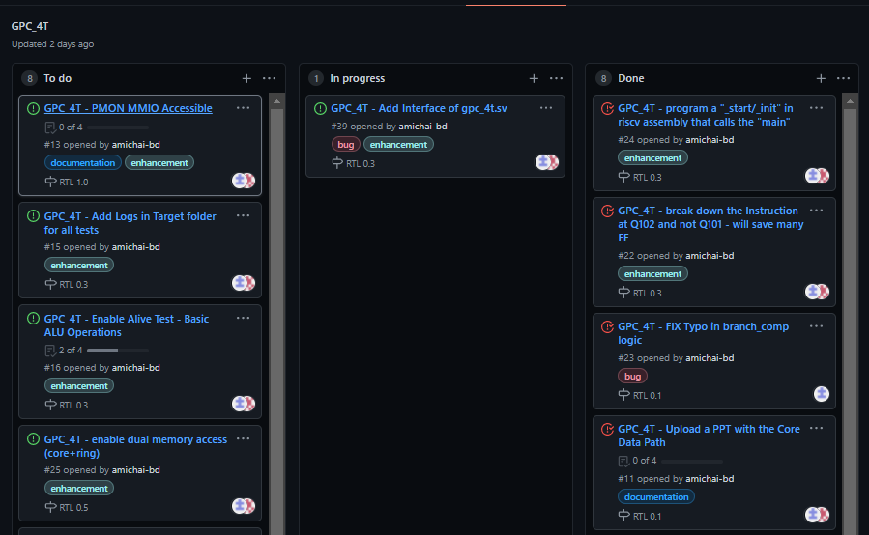
GitHub
https://github.com/amichai-bd/riscv-multi-core-lotr

Slide 44
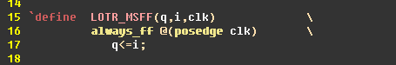
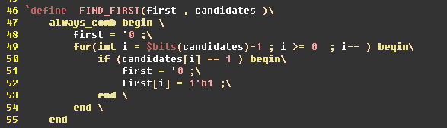
Design – RTL System Verilog
Coding Style
Macros

Slide 45
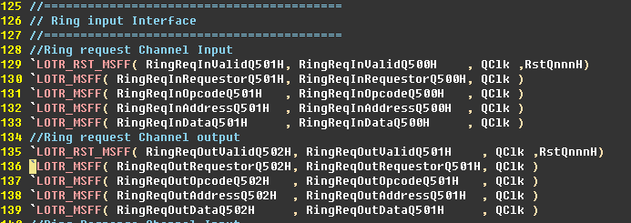
Design – RTL System Verilog
Coding Style
Macros
Naming convention <signal>Q502H

Slide 46
Design – RTL System Verilog
Process Agnostic - compatible with:
Simulation
FPGA
ASIC

Slide 47
Validation
RC Level: Simple TB for enablement –
Fabric LOTR Level: Integrating to the LOTR Fabric and executing “real” flows.
**Note: More validation is WIP for future projects

Slide 48
Question?

